Slide 1
Fun Statistics
Neal Yu

Slide 2
Agenda
1. Monty Hall Problem
2. Symptom and Disease
3. Statistical Significance
Notes:
Monty hall problem: sometimes intuitive is not that accurate.
Symptom and disease: when looking at stats, don’t just focus on a few numbers, sometimes we have to look at the whole picture.
Statistical significance: critical thinking, brave to show doubt against authorities.

Slide 3
Agenda
1. Monty Hall Problem
2. Symptom and Disease
3. Statistical Significance

Slide 4

Monty Hall problem
In a game show, you are in front of three doors. Behind one of the doors, there is a big price, say a luxury car. While behind the other two are something weird, say a goat.
Suppose you select door 1 initially. Now the host tells you there is no price behind door 3.
Are you going to stick with your original choice (door 1) or switch to the remaining other one (door 2)?

Slide 5
answer
You should switch your choice
Not switch
1/3 to win
Switch
2/3 to win

Slide 6
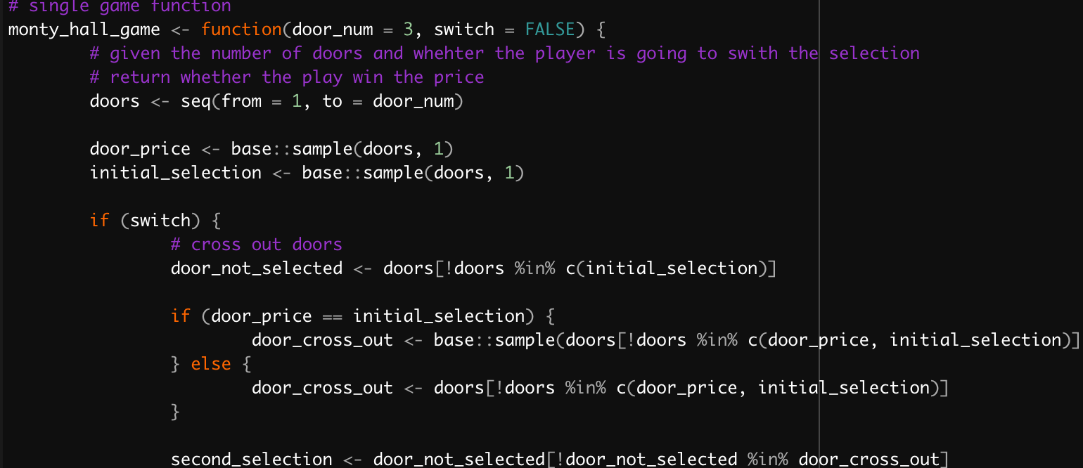
explanation
Simulation in statistical software R.
Common explanations.
Treat door 1 as one group (1/3), door 2 and door 3 as another group (2/3).
Extend 3 door to 100 doors.
Information matters.
Your choice should be reevaluated when you receive more information.
Notes:
Here’s the general idea: The more you know, the better your decision.
Monty helps us by “filtering” the bad choices on the other side. It’s a choice of a random guess and the “Champ door” that’s the best on the other side.

Slide 7
Agenda
1. Monty Hall Problem
2. Symptom and Disease
3. Statistical Significance

Slide 8
Symptom and disease
Suppose in a disease diagnostic study, we obtained the observation data below. Can we say symptom and disease has a positive relationship?
 | Disease present | Disease absent
Symptom present | 80 | 40
Symptom absent | 20 | 10
If we only look at the first column, we may conclude yes. Since 80% (80 out of 100) of the people who has disease actually shows symptom.
If we look at all four cells, we may conclude not really. Since for all people who shows symptom, 67% (80 out of 120) has disease, while for all people who shows no symptom, again 67% (20 out of 30) has disease.
Sometimes when we look at statistical numbers, we need to look at the whole picture.

Slide 9
Questions

Slide 10
Backup Slides

Slide 11
100 doors

